Slide 1
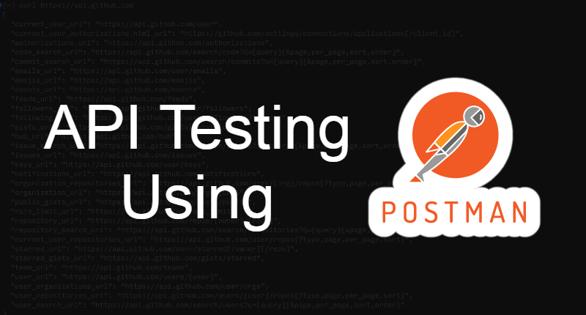
By - Manas Tuwani

Slide 2
What is an API ?
API Stand for Application Programming Interface
It enables data exchange between two separate software
API stands for Application Programming Interface. API acts as an interface between two software applications and allows the two software applications to communicate with each other. API is a collection of software functions that can be executed by another software program.

Slide 3
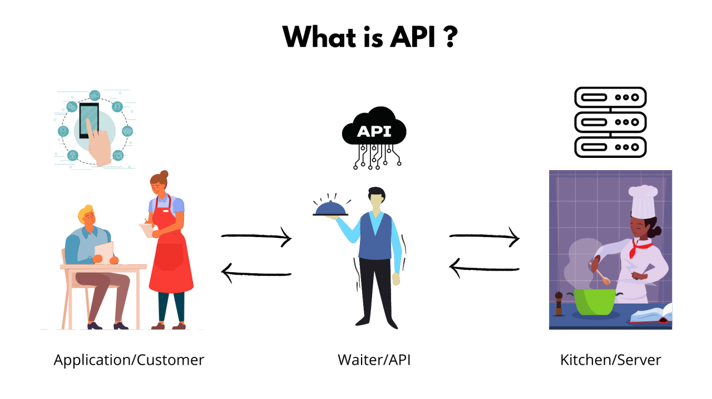

Slide 4
What is API Testing?
API testing is a type of software testing that involves testing APIs directly and also as a part of integration testing to check whether the API meets expectations in terms of functionality, reliability and providing correct response or not

Slide 5
Web Service
When we move API from local to production environment then the API is called Web service. Web service is an API which is wrap in HTTP.
Services available over the web.
The method of communication between two devices or application over the network.
Enable communications between applications over the web.
Platform independent communication.
Using web services two different applications(Implementation) can talk to each other and exchange data/information.

Slide 6
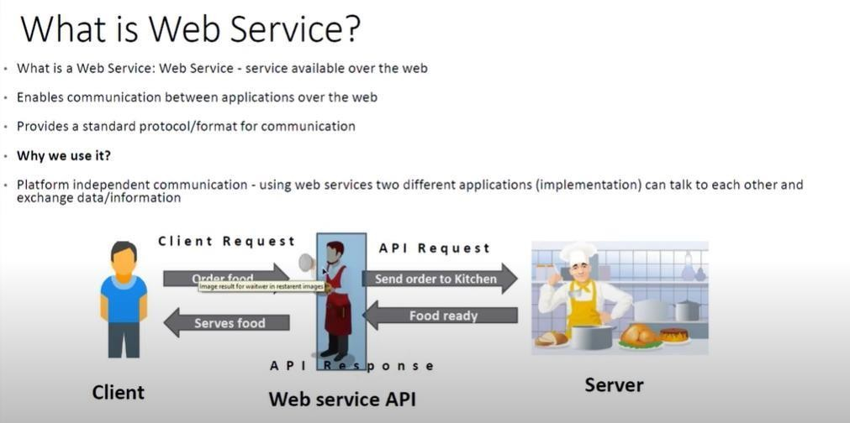

Slide 7
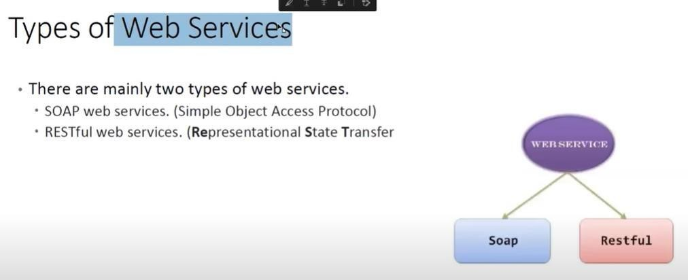

Slide 8
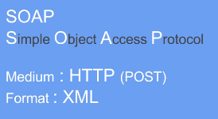
SOAP API
SOAP is a very old and complex technology and its only supports XML for communication. It supports only POST requests only.
SOAP stands for Simple Object Access Protocol. It is an XML based messaging protocol. It helps in exchanging information among computers.

Slide 9

REST API

Slide 10
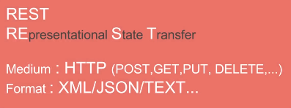
REST API
RESTful is the latest technology and its supports multiple ways to communicate like XML, Text, HTML, and JSON, and it supports multiple operations like Post, Put, Get, Delete, Patch etc. Most of companies are using RESTful API nowadays as it’s the latest and has more features.
REST stands for Representational State Transfer. It is a set of functions helping developers in performing requests and receive responses.

Slide 11
Difference between SOAP and REST
REST
SOAP
REST stands for REpresentational State Transfer.
REST permits different data format such as Plain text, HTML, XML, JSON etc.
REST is faster than SOAP
REST more preferred than SOAP.
Rest support multiple request method (POST, GET, PUT, etc…)
SOAP stands for Simple Object Access Protocol.
SOAP permits XML data format only
SOAP is slower than REST.
SOAP is less preferred than REST.
SOAP Support only POST request.

Slide 12
Difference between UI Testing and API Testing
UI (User Interface) Testing is to test the graphical interface part of the application. Its main focus is to test the look and feel of an application. In User Interface Testing the main focus on how users can interact with application elements such as Images, fount, layout etc. are checked.
On the other hand, API testing enables the communication between two different software systems. Its main focus is in the business layer of the application. API Testing works on the backend part of application that’s why it is also known as Backend Testing.

Slide 13
Miscellaneous
What is Idempotency?
An API is idempotent if making the same request multiple times produces the same result.
Example: GET is idempotent PUT is idempotent
What is Swagger?
Swagger is a tool used for API documentation and testing.
Now known as: Swagger UI

